Slide 1
Public Meeting on Proposed Development Applications for: Millford Development Ltd. 55 Eagle Street, Newmarket, ON Monday, February 27, 2012

Slide 2
INTRODUCTION
Planning Justification Report:
Peter E. Allen President Peter E. Allen and Associates
Planning Consultants
Architecture & Urban Design:
John de Valence Partner PDA Architects
Proposed
Residential Development
55 Eagle Street, Newmarket ON

Slide 3
SUPPORTING RESEARCH & REPORTS
Planning Justification Report
Natural Heritage Information
Landscape Master Plan
Stage 1 Archaeological Assessment
Soil Investigation Report
Phase 1 and Phase II Environmental Site Assessment
Hydrogeological Study
Traffic Impact Study
Functional Servicing and Stormwater Management Report
Shadow Impact Study
Preliminary Environmental Noise Report
Site Lighting Calculations
Proposed
Residential Development
55 Eagle Street, Newmarket ON

Slide 4
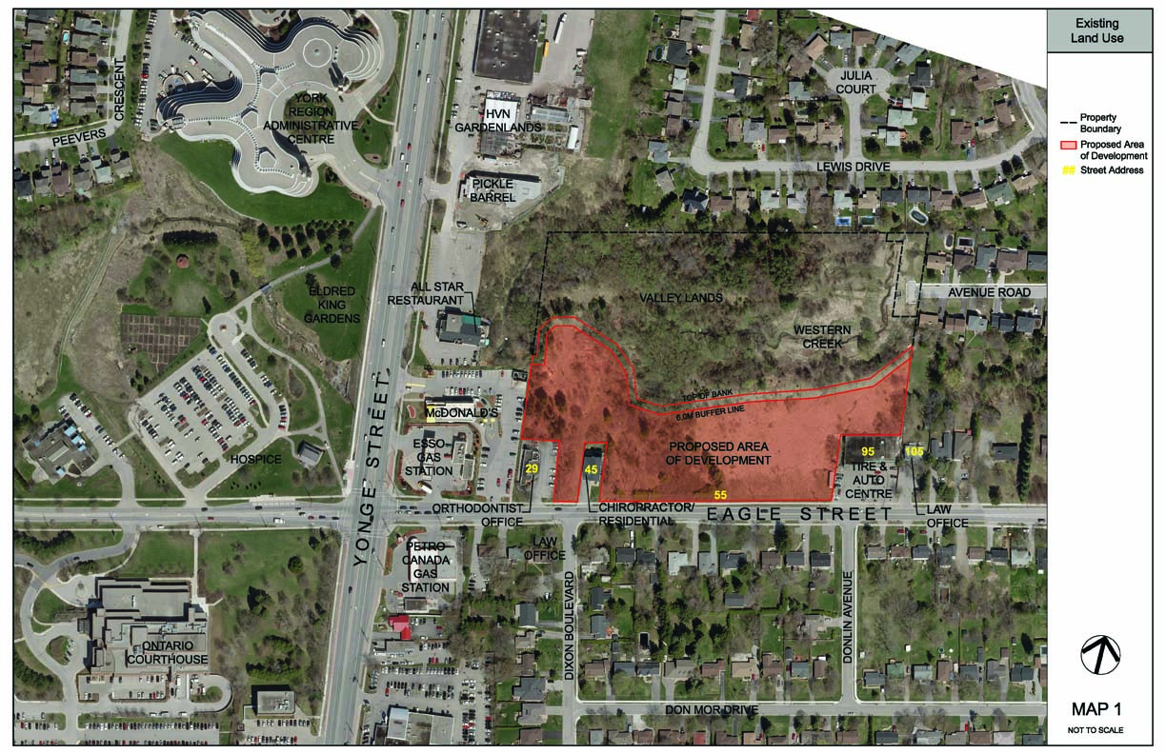
EXISTING LAND USE
Proposed
Residential Development
55 Eagle Street, Newmarket ON

Slide 5
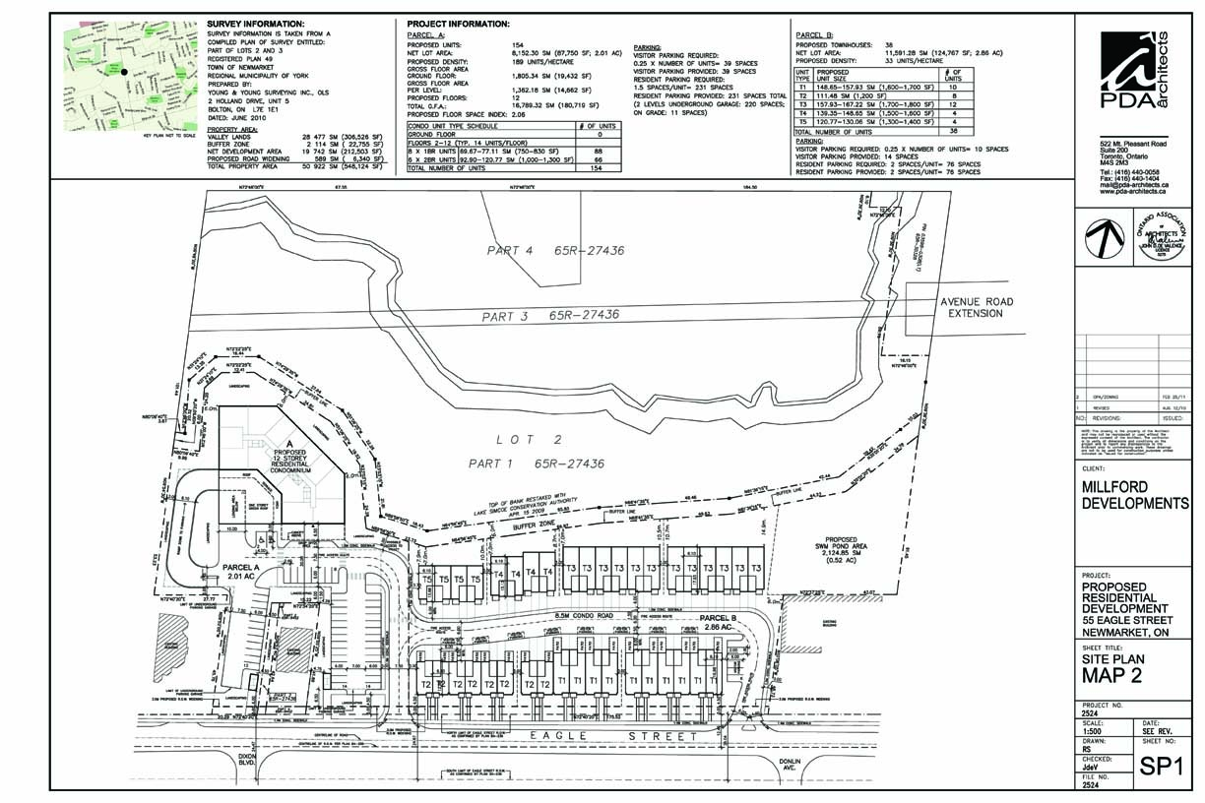
PROPOSED SITE PLAN
Proposed
Residential Development
55 Eagle Street, Newmarket ON

Slide 6
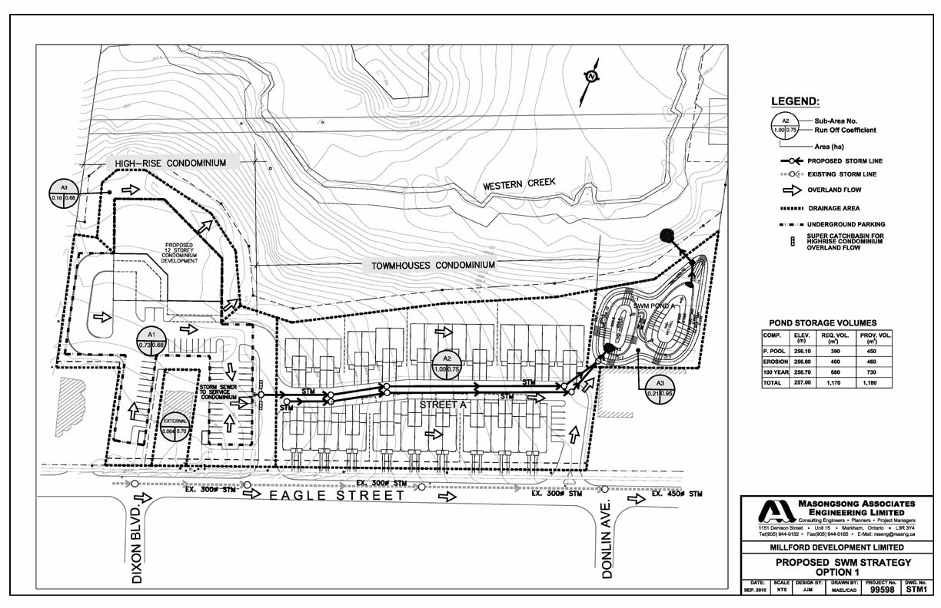
PROPOSED SWM STRATEGY
Proposed
Residential Development
55 Eagle Street, Newmarket ON

Slide 7
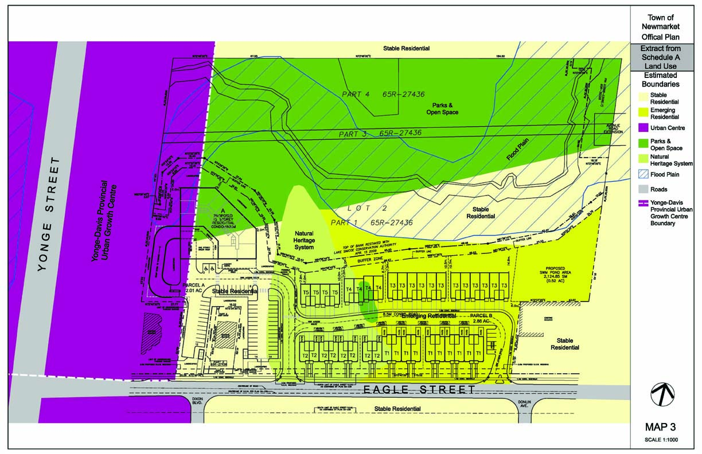
MAP 3
Proposed
Residential Development
55 Eagle Street, Newmarket ON

Slide 8
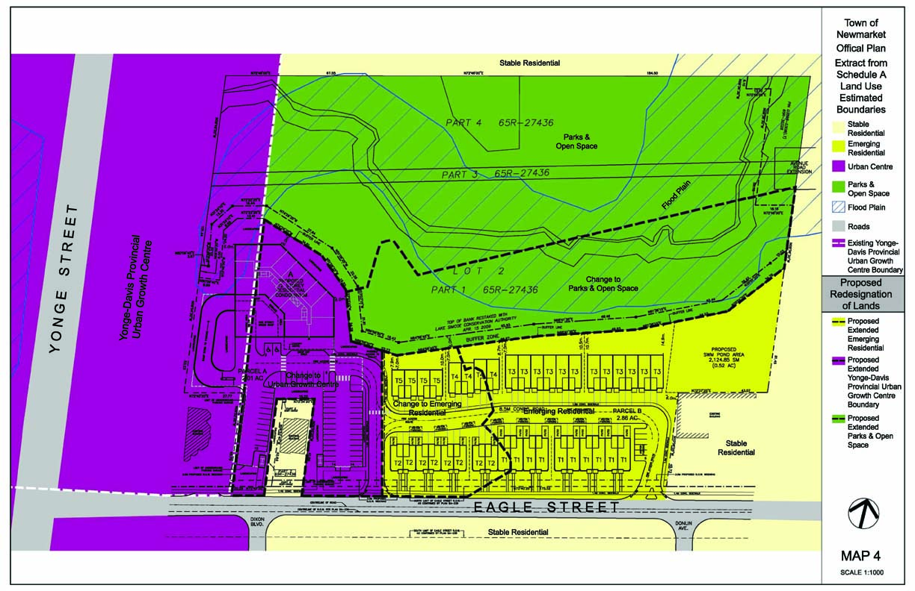
MAP 4
Proposed
Residential Development
55 Eagle Street, Newmarket ON

Slide 9
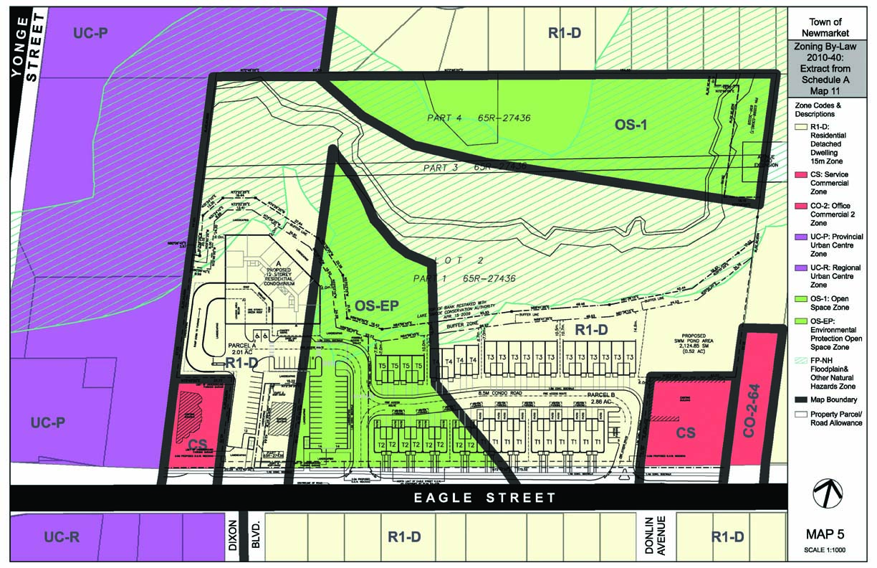
EXISTING ZONING
Proposed
Residential Development
55 Eagle Street, Newmarket ON

Slide 10
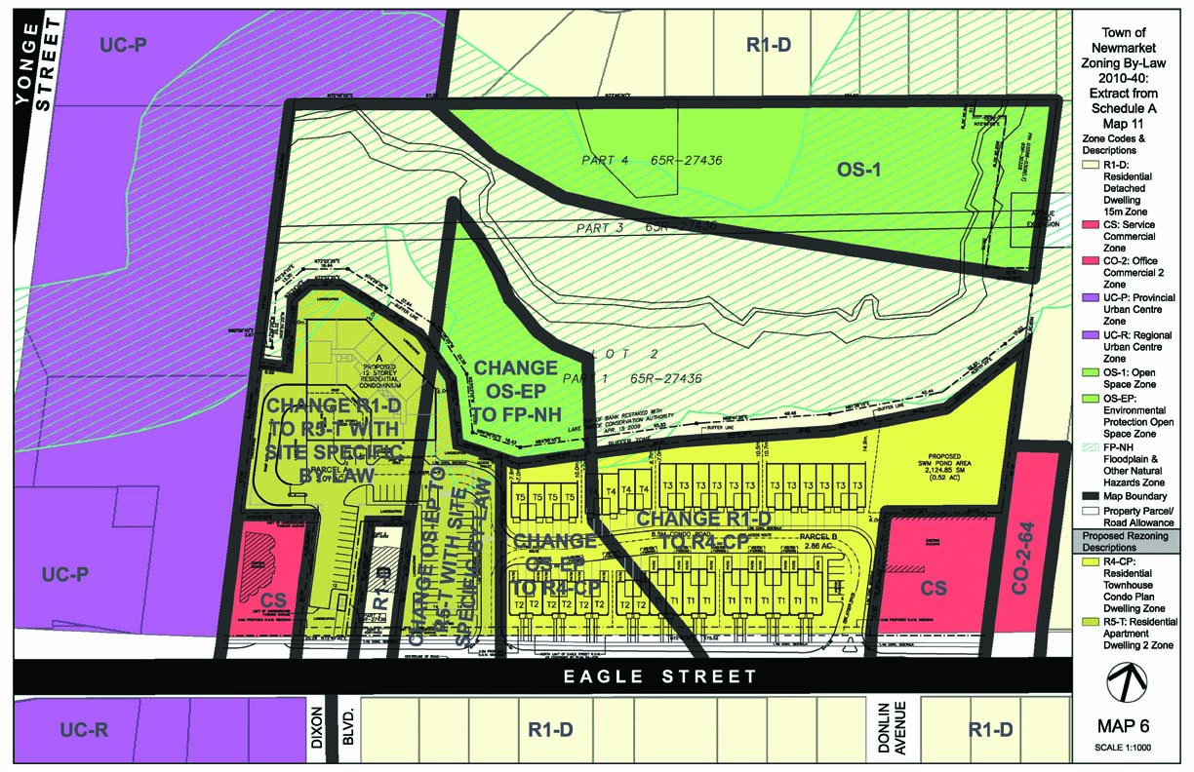
PROPOSED ZONING
Proposed
Residential Development
55 Eagle Street, Newmarket ON

Slide 11
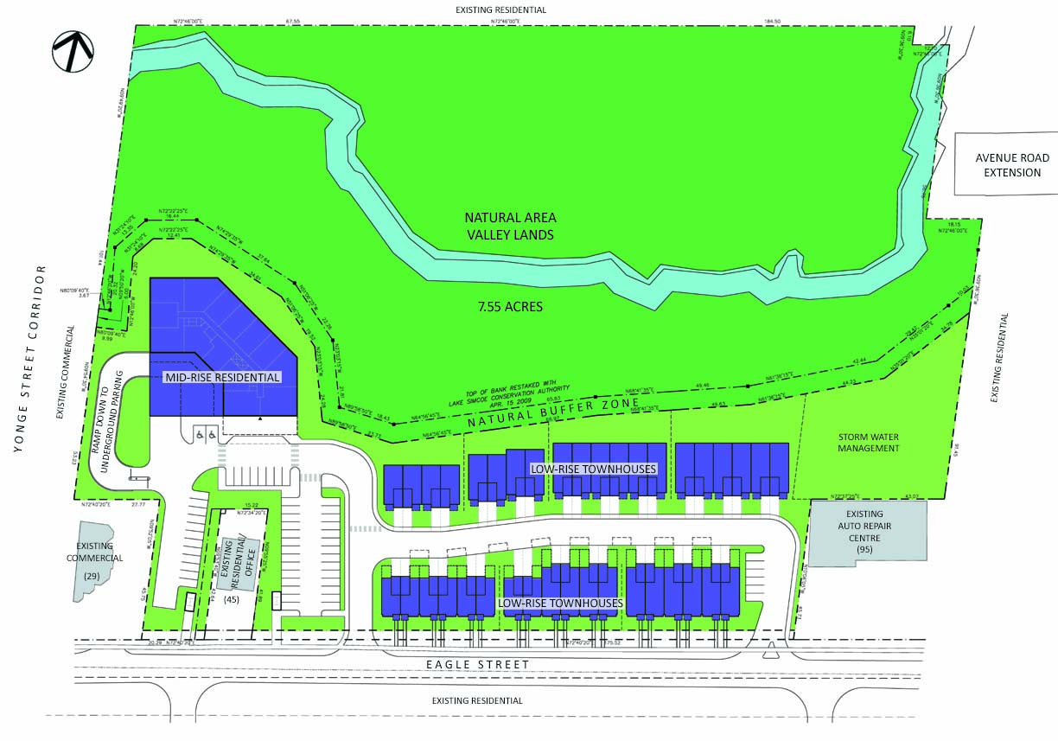
DEVELOPMENT CONCEPT
Proposed
Residential Development
55 Eagle Street, Newmarket ON

Slide 12
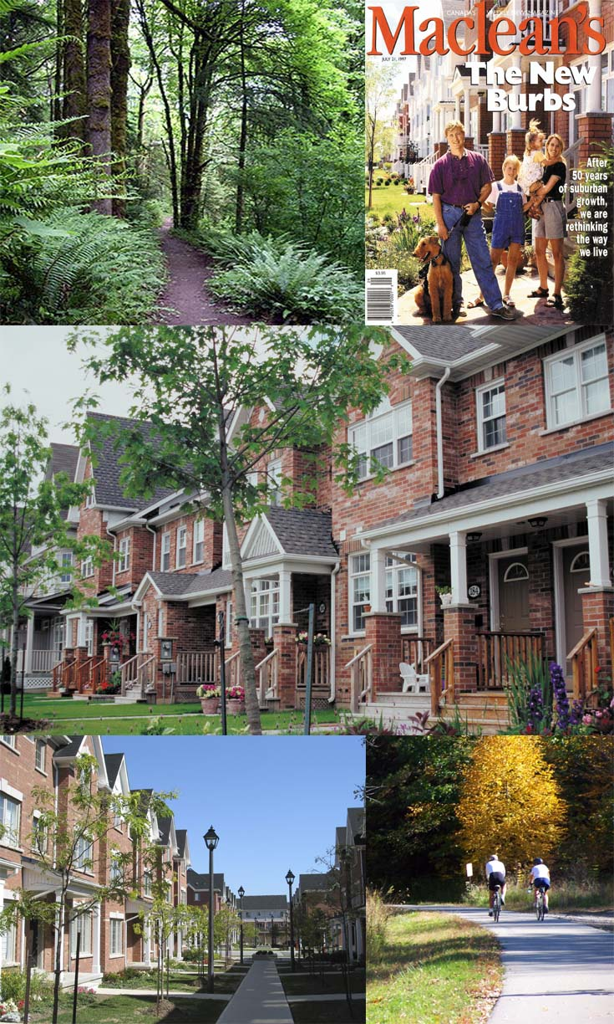
URBAN DESIGN CONCEPT
Context Sensitive Design Approach
Responsive to Natural Environment in Valley
Compatible with Adjacent Neighbourhood
Responsive to Planning Objectives of the Yonge Street Corridor
High Quality Urban Design
Streetscape with Porches and Bay Windows to integrate with Existing Neighbourhood
Internal Roadway System
Pedestrian/Bicycle Connectivity to new development and Valley
Attractive, Liveable Community
Natural Area in Valley with Walking and Bicycle Trails
Sustainable Design Principles
Safe Community Design Principles
Proposed
Residential Development
55 Eagle Street, Newmarket ON

Slide 13
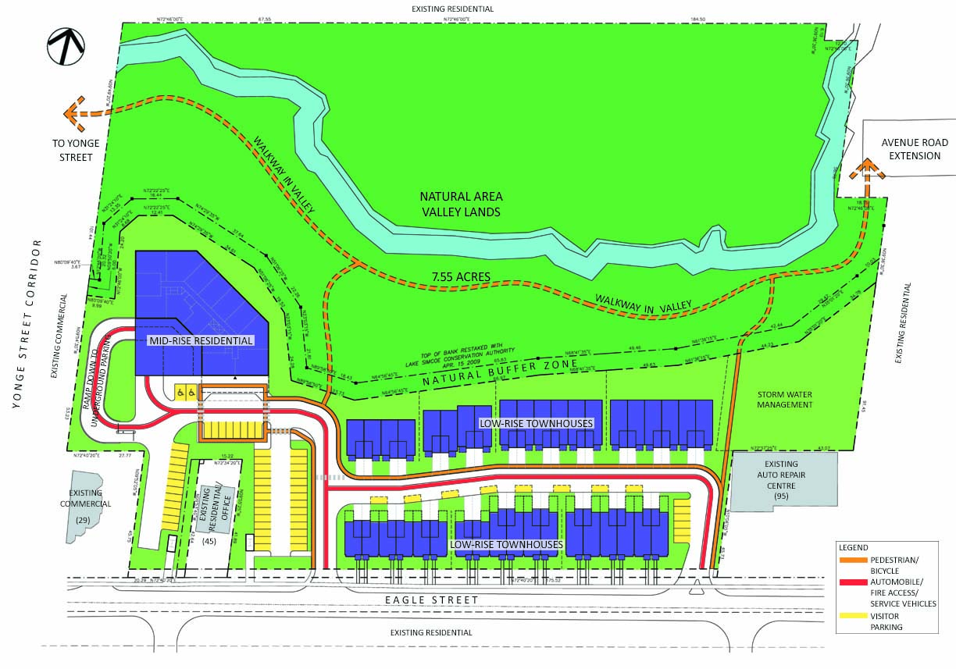
MOVEMENT SYSTEMS
Proposed
Residential Development
55 Eagle Street, Newmarket ON

Slide 14
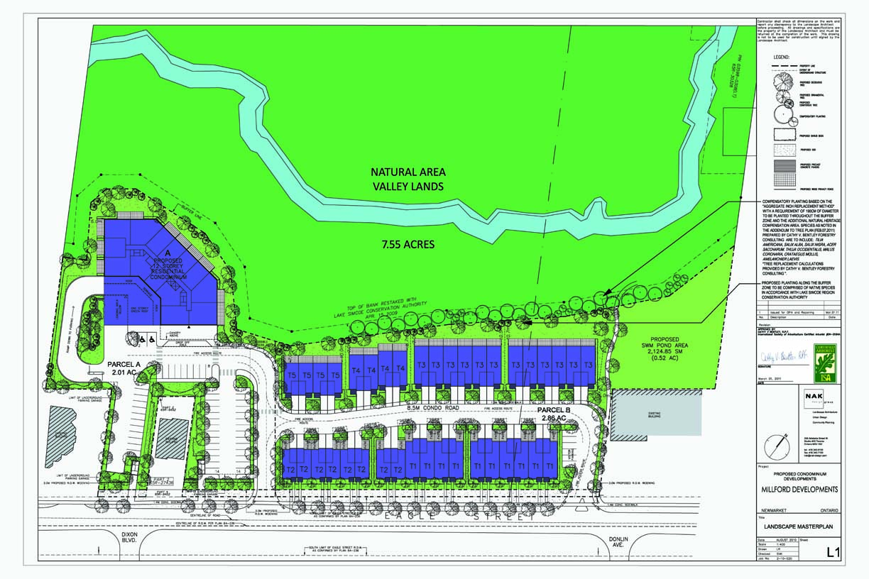
LANDSCAPE DESIGN
Proposed
Residential Development
55 Eagle Street, Newmarket ON

Slide 15
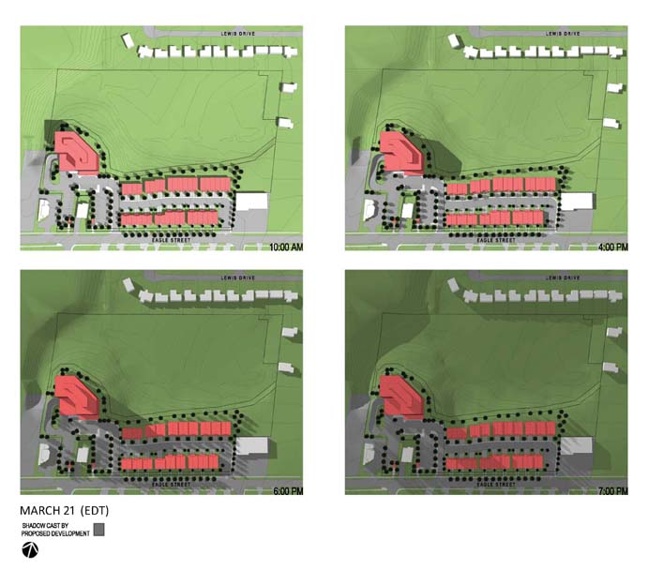
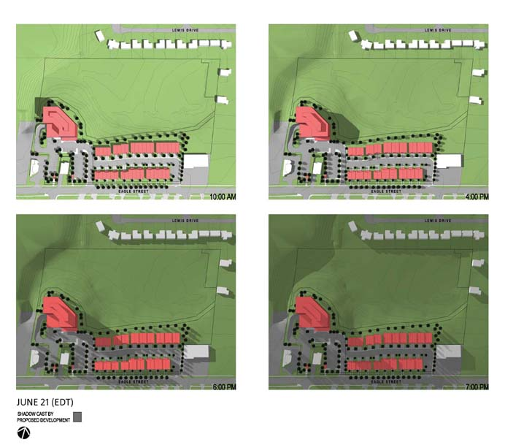
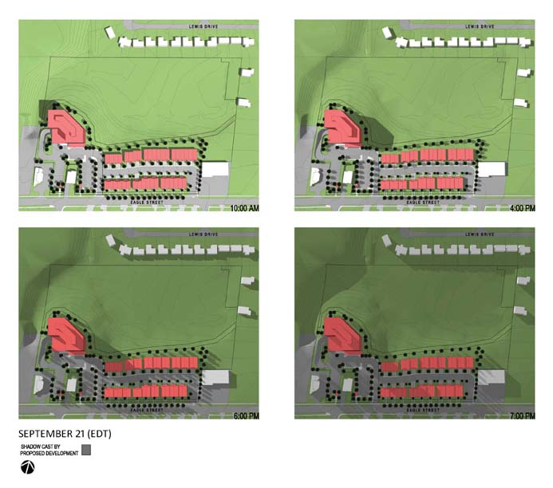
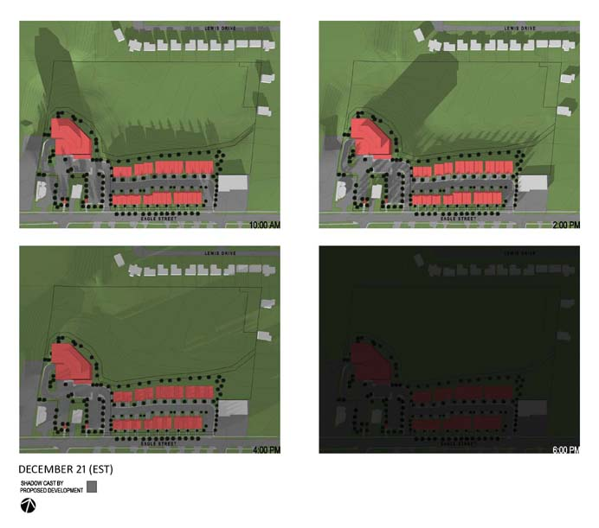
SHADOW IMPACT STUDY
Proposed
Residential Development
55 Eagle Street, Newmarket ON

Slide 16
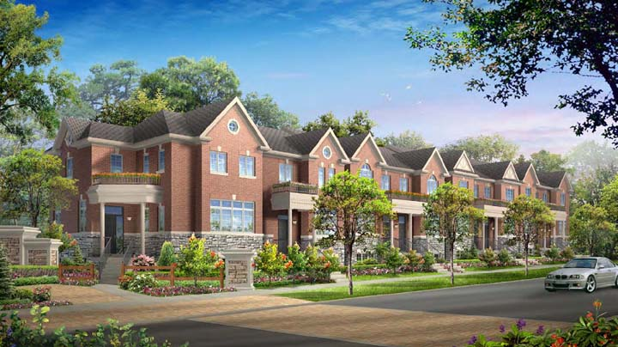
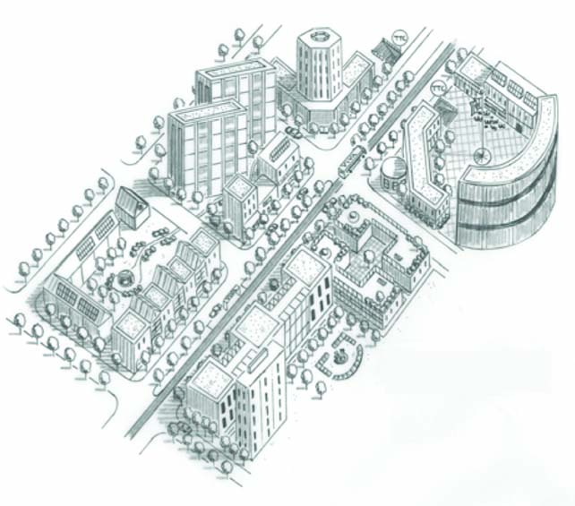
BUILT FORM COMPATIBILITY
Proposed Townhouses
Compatible built form with adjacent stable residential neighbourhood
Streetscape with front porches and bay windows. Locate garages on internal roadway.
Natural Buffer to the Valley
Proposed Mid-Rise Residential Building
Compatible built form with Town and Regional planning objectives for Yonge Street Corridor
30.0 M Separation distance with 49° angular plane to adjacent existing building at 45 Eagle Street.
Acoustic and landscape buffer with new
6.0 M evergreen trees.
Natural Buffer to the Valley
Proposed
Residential Development
55 Eagle Street, Newmarket ON

Slide 17
SUSTAINABLE DESIGN
Sustainable Design Approach
Sustainable Building Design:
Improved Energy Performance of Buildings
Meet new energy performance standards of the 2012 Building Code for all buildings
25% improvement to energy performance standard of the MNECB for mid-rise building
Integrate Sustainable Building Technologies where appropriate
Use of Sustainable and Locally Sourced Materials where appropriate
Use of Recycled Materials where appropriate
Reduction in waste materials
Integrate Water Efficiency where appropriate
Integrate Energy Efficient Electrical Systems where appropriate
Provide Purchaser Option to Upgrade to Higher Performance Systems
Sustainable Site Design:
Sustainable Storm Water Management
Ground Water Recharge
Integrate Rainwater Harvesting where appropriate
Sustainable Landscape Design
Energy Efficient Site Lighting
Implementation:
Provide Detailed Implementation Plan at Site Plan Approval and Building Permit Approval Stages
Proposed
Residential Development
55 Eagle Street, Newmarket ON

Slide 18
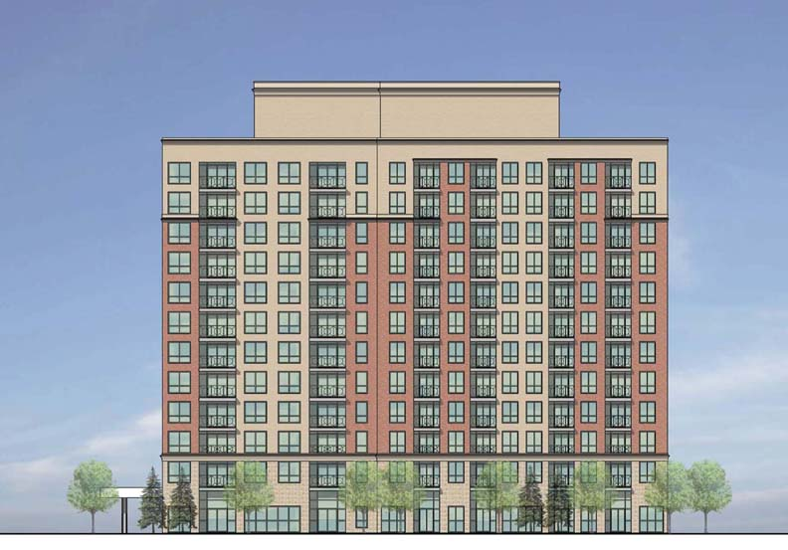
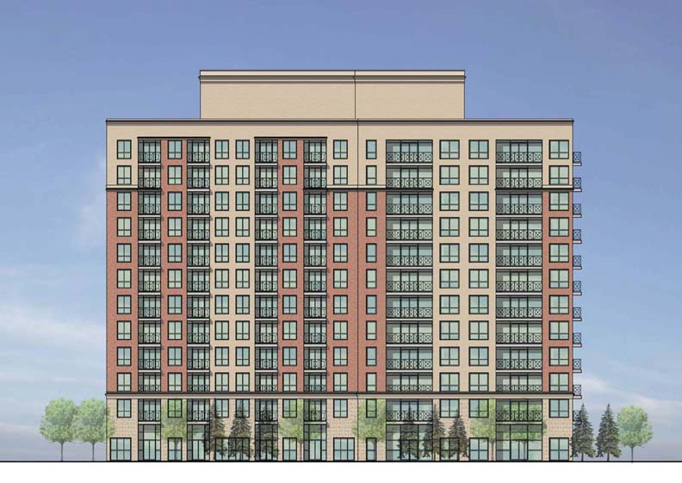
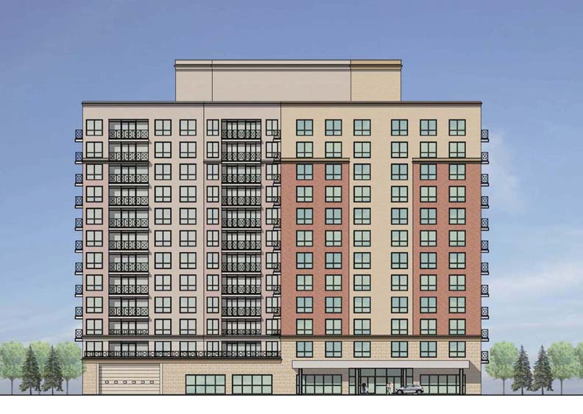
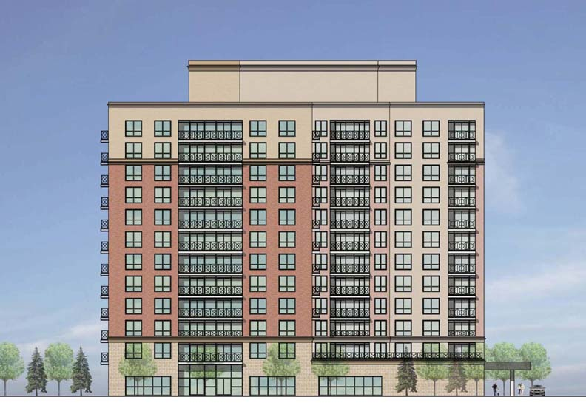
ARCHITECTURAL DESIGN
Mid-Rise Residential Building
EAST ELEVATION
NORTH ELEVATION
SOUTH ELEVATION
WEST ELEVATION
Proposed
Residential Development
55 Eagle Street, Newmarket ON

Slide 19
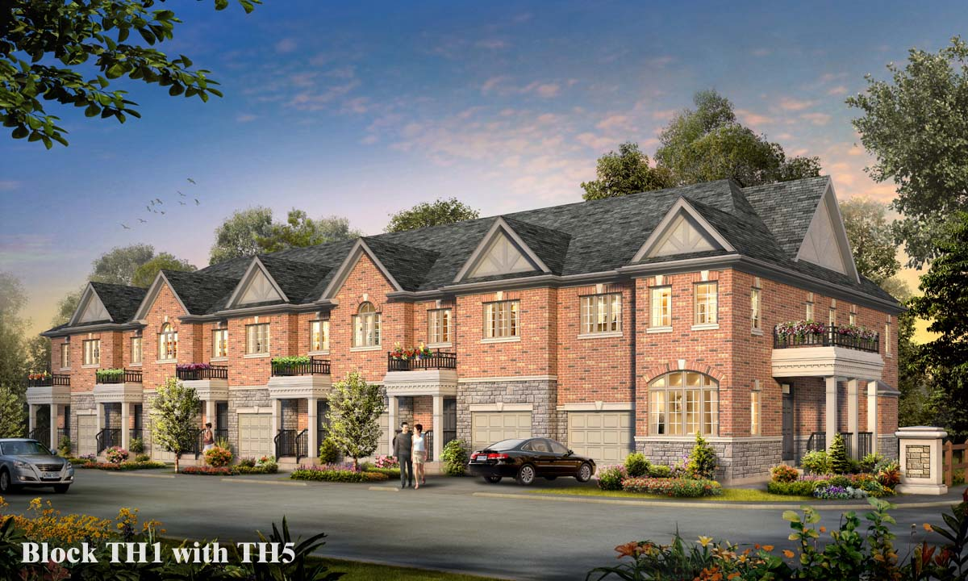
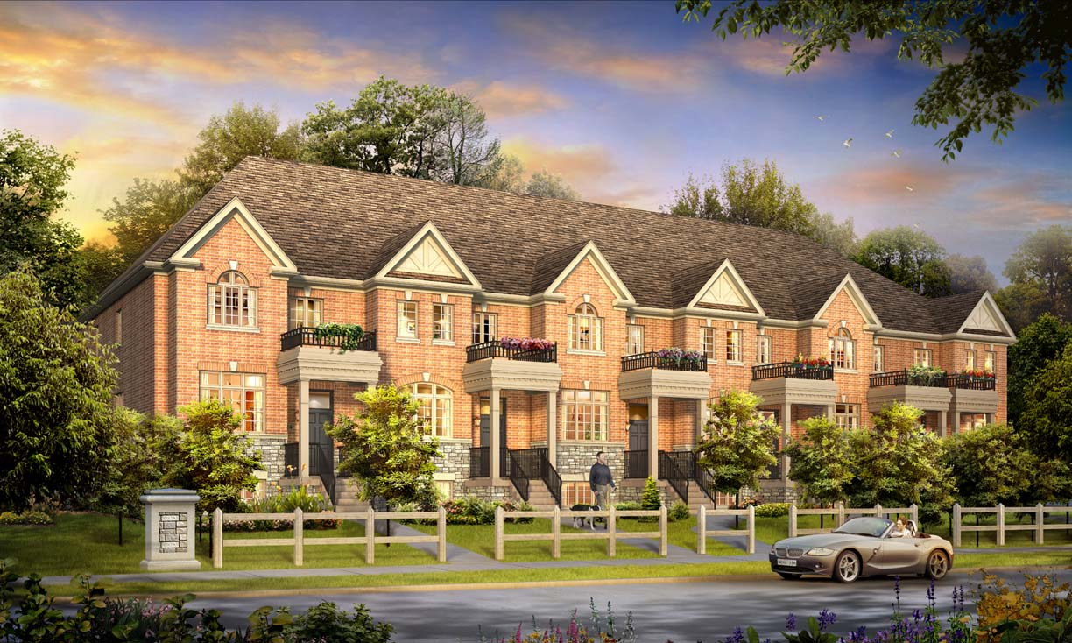
ARCHITECTURAL DESIGN
Low-Rise Residential Buildings
TOWNHOUSES ADJACENT TO VALLEY
TOWNHOUSES ADJACENT TO EAGLE STREET
Proposed
Residential Development
55 Eagle Street, Newmarket ON

